Slide 1
http://www.advancemovement.com/planting/planting-news/
Advance Quarterly Prayer Points
Thank you so much for being willing to partner with us in praying regularly for items affecting those within the Advance movement. Please feel free to circulate these prayer points to your leaders, church community and prayer groups.

Slide 2
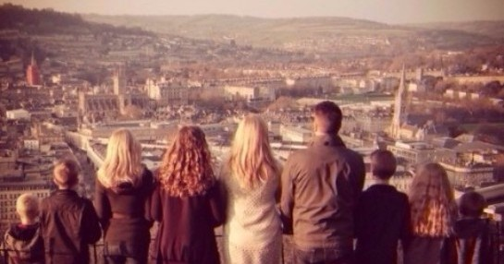
EUROPE:
Dan Romer and his family are planting in Bath, UK and have felt called to start a movement of creative gospel communities on mission. Their church is based on 3 core values: gospel message, gospel mission and gospel community.
Please join them in praying for:
1. Restoration of the gospel message among churches, communities and culture. 2. A great missional movement of gospel communities. 3. Lots of healthy multiplying gospel communities with new birth, gospel-centred life, and healthy leaders.

Slide 3
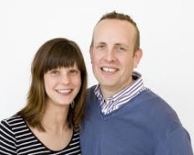
London
Nik and Claire Ball lead Christ Central church based in Redhill town centre, London. As a church they have felt called to be a place of hospitality and have made great connections with the community through their artisanal coffee shop, hosting drop in centres and a clinic in their building. This allows the community opportunity to connect with church in an accessible and non-threatening way.
Please join them in praying for: 1. The church as they serve at events in the community. Please pray that people are connected to church through their outreach at these events
2. That new members will be established into community, and for God to ignite them as a church to 'go again'. 3. New believers, especially those with mental and health issues, to be gathered to the church through the evangelistic events that the church has invested in over the years.

Slide 4
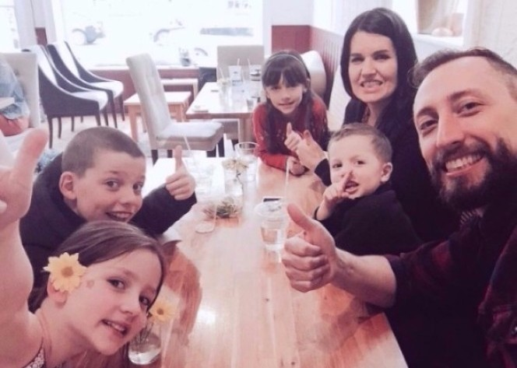
North America
City Gates Church is led by Vic and Tanya Stander, and exists to help people find and follow Jesus. They meet in a town called Ajax, just east of the city of Toronto – one of the most cosmopolitan cities in the world. The church has been in existence for 21 years, and has seen it’s share of changes in terms of location, theology, name, partnerships and leadership.
Please join them in praying for: 1. The church as it is in transition, and needs God's ongoing wisdom as they continue to re-engineer City Gates for a new season. Please pray for the Stander family who are transitioning into Canadian culture, cultivating relationships within City Gates and the wider community that they are part of. 2. Fresh converts particularly among the Hindus and Muslims living in the area. Please pray that their manifesto to "help people find & follow Jesus” moves from something they say to something they see. 3. Apathy to be broken and that people are motivated into action because of genuine gospel concern. The idol of comfort is pretty prevalent, often holding people back from accepting the demands of the great commission.

Slide 5
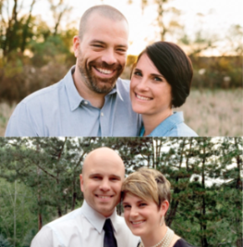
Benson
Citylight Benson is a new church plant that launched in September 2015 by JD and Michelle Senkbile, and Tyler and Lindsey Zach. Their mission is to multiply disciples who "Love God and Love Benson." Benson is a historic Omaha neighborhood that is experiencing a cultural renaissance and is attracting many young musicians and artists. In addition to reaching creatives, the church is actively seeking to serve neighbourhood residents, refugees, high school students, and an elementary school across the street.
Please join them in praying for: 1. Neighbourhood residents to come to know Jesus and get baptized this year. 2. Wisdom and direction as they turn their north building into an arts centre for the welfare of Benson. 3. Love and theological unity among the church staff and ministry leaders.

Slide 6
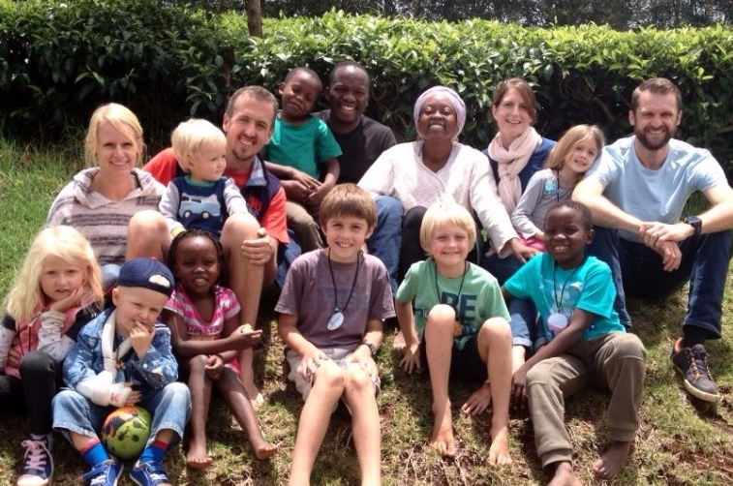
Africa:
Nairobi is a vibrant and innovative African city, with a tremendous amount of influence on the rest of East Africa. The Malabas, Massingham and Anderson families have embarked on the adventure of planting and are trusting God for a grace-boasting, gospel-centred church plant that sees lives, and ultimately the city, transformed by Christ
Please join them in praying for: 1. God to call a vibrant core of Kenyan families to be passionately on mission with them. 2. Great insight into the hearts of Nairobians - how to present the gospel in a way that is winsome to “not–yet believers” and a blessing to the city. 3. A deep sense of unity, equipping and empowering for the core families – they want to run their race well as a team

Slide 7
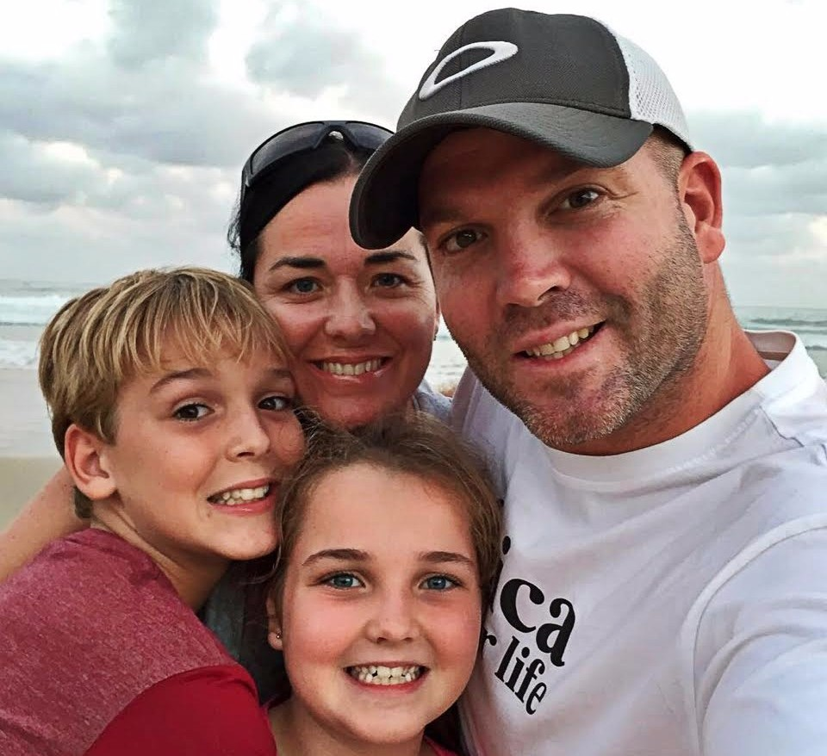
East London
Stirling Baptist Church is a vibrant multi-site church with a big heart for East London led by Matt and Anthea Francis. Their dream is to build a Christ-centred community where lives are transformed, the City is restored and the nation is inspired. God has opened doors for them as they have engaged in compassion and justice ministries including saving abandoned babies, pre-abortion counselling in State hospitals, building homes, and creating jobs for the unemployed.
Please join them in praying for: 1. God’s provision in rebuilding their pastoral ministry. Last year the church lost key members of their pastoral team due to a death, retirement and relocation. 2. Wisdom as they embark on restructuring their Home Building ministry for greater impact. 3. Salvations - that those exploring faith would come under the conviction of the Spirit and respond to His call.

